Slide 1
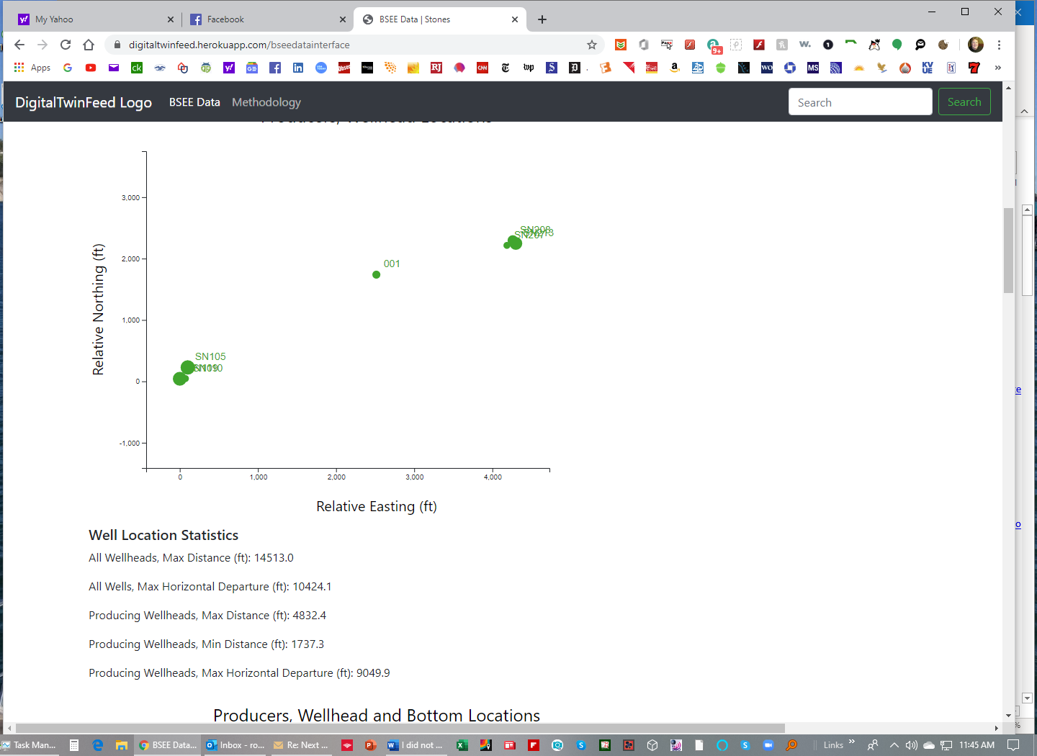
Would be nice here to be able to say we have two drill centers and provide stats on each of the drill centers as well.
Also provide an excel download to manipulate the data with graphs?

Slide 2
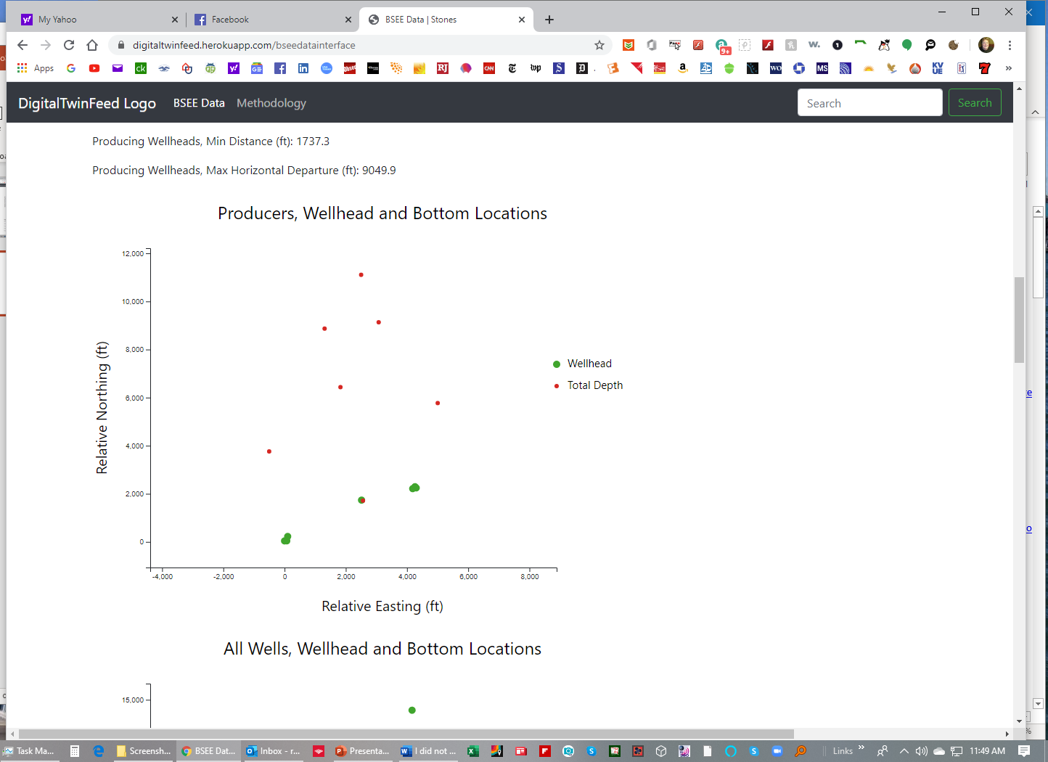
Would be nice to have the well names denoting the shl and bhl. Possibly put a line from the surface hole to the bhl so that we can see which is which.
Excel download also very desirable so engineer can play with data.

Slide 3
Vamsee outstanding great work. See some more user wants on the ppt attached. Also we need to provide a way for the user to select the blocks to query so we can look other fields as well. Let me know if you have any questions or need any clarification. I love the Well Activity Remarks because we can go through and read what was going on. Most of the comments attached are suggesting Excel or Word export capabilities to be able to work and print the data from the user’s desktop.
Other Comments in Email
a/ Re: Reserves for Cascade-Chinook. Not sure I understand what is going on with the two sets of green and yellow lines?
b/ All Tubulars, Raw Information. This table should be grouped by well name, then hole size, then casing setting depth
c/ Including sidetracks, I counted 20 wellbores on Stones, 18 on Cascade Chinook and 10 on Julia. WOW these guys need and FrPS bad. I would suggest we also show water depth in this table as well as the calculated footage drilled and days per 10,000’

Slide 4
Lower Teritiary - Fields of Interest
??

Slide 5
General Improvements
Make data downloadable at each table (Done)
https://gist.github.com/doobeh/239b1e4586c7425e5114
https://stackoverflow.com/questions/35774060/determine-which-wtforms-button-was-pressed-in-a-flask-view
https://stackoverflow.com/questions/36090695/flask-wtforms-how-to-make-a-form-with-multiple-submit-buttons
Ask for Vijay’s comments on:
Entire page and flow
Make tables scrollable again? Investigate the needed table function in latest bootstrap.

Slide 6
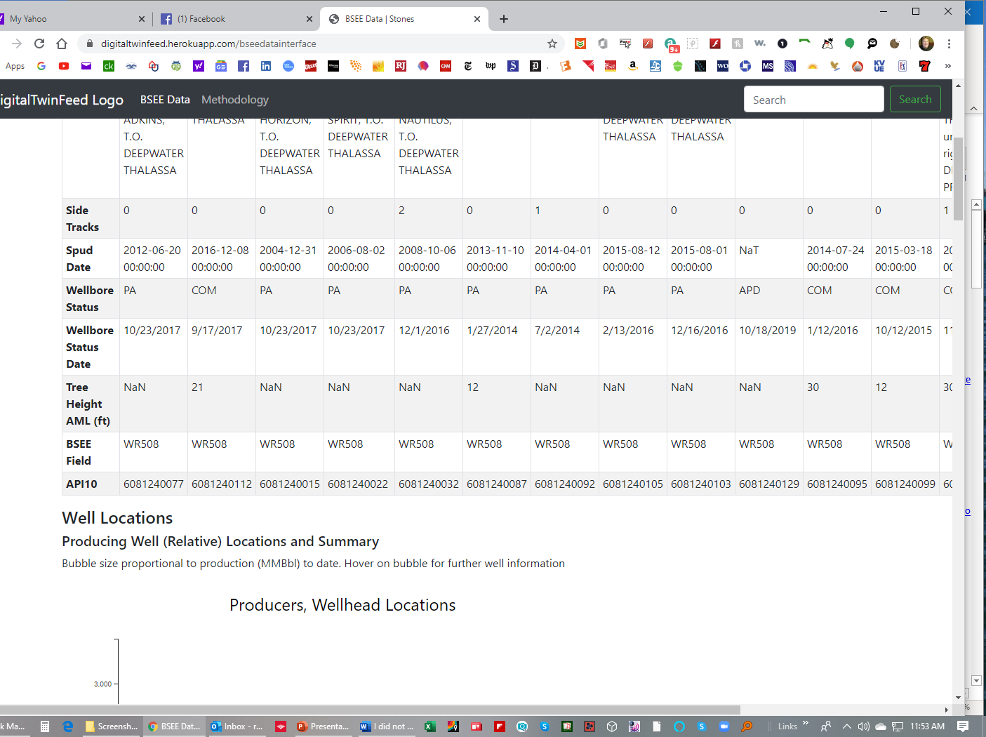
Add a row that shows the calculated drilling and completion days?

Slide 7
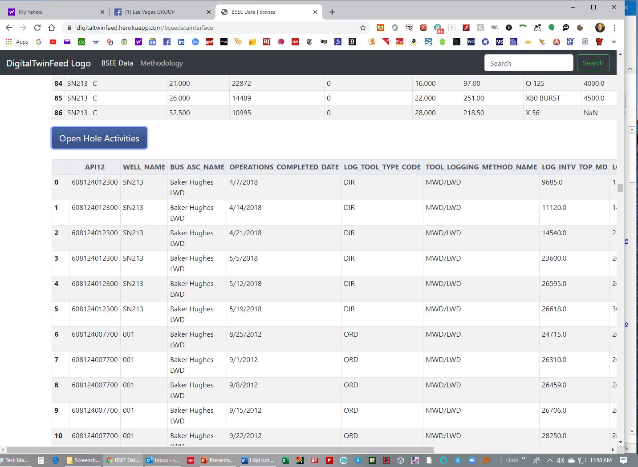
Would be nice to have this table grouped by wells. Would be extremely helpful if there was an export to Excel function for each table.
I wonder if it is possible to display each table in Excel so the user can manipulate on screen?

Slide 8
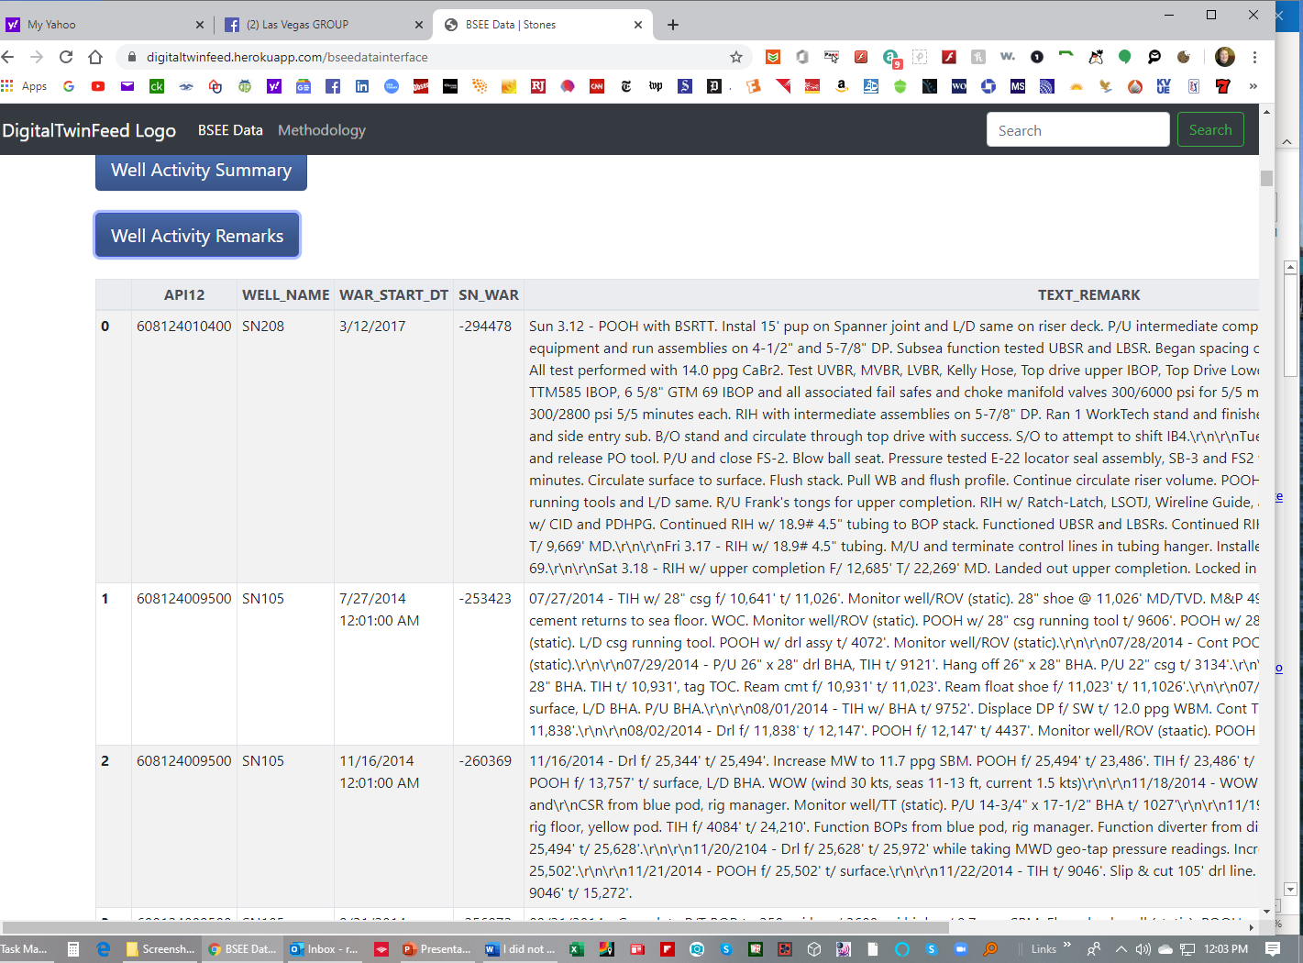
I absolutely love this table. We can read what happened on each well!
Would be nice to have either an excel or word export function by well so the info can be easily download and printed.
Need to make sure the table is sorted first on well name, then shows activities in chronological order

